Slide 1
DoorDash
Design Sprint
Product Manager: Francesco Malagrino
© 2019 Udacity. All rights reserved.

Slide 2
Set the stage
Set the stage for the Design Sprint by framing the problem
© 2019 Udacity. All rights reserved.
Notes:
[ALL PARTICIPATION]

Slide 3

Initial PRD
Link your PRD

Slide 4
Understand
Create a shared understanding of the space, problem, and goals
© 2019 Udacity. All rights reserved.
Notes:
[ALL PARTICIPATION]

Slide 5
Sorted Stickies
Prevent bad choice Change other behaviour Be more active Other
How we might decide the correct number of items to recommed?
How might we overcome technical glitches during a delivery and an order?
How might we streamline communications between operators and robots?
How might we address a sudden power outage?
How might we
Increase robot speed?
How might we accept tips that some customers may want to give a robot?
How might we make inertacting with robots more fun?
How might we teach empathy to robots?
We may use robots if the delivery items is around 2/35 meters
How might we program robots to address customer returns?
How might we program robots to address delays in deliveries?
How might we enable robots to interpret and speak different languages?
How might we allow robots to detect real-time traffic patterns?
How might we enable robots to detect missing items in the order during pickup?
How might we alert operators of need for robot intervention conveniently?
How might we enable robots enter a crowded restuarant to pickup food?
How might we make our robots act like people?
How might we help robots talk to peope?
How might we prepare robot to handle deliveries to persons with disabilities?
How might we program robots to address order cancellations?

Slide 6
Sprint Focus
Focus | We will use a recommend system and the customer can decide if pickup the product or a delivery system
Slide # | Slide 12
I selected this theme because | I select this because is crucial for our business we will build a recommendation system that will help the customer to not forget to buy food that they needs based on their past purchase, plus they will choice if pickup at the store or delivery services

Slide 7
Define
With an understanding of the problem space, create focus and align on specific outcomes for the Design Sprint
© 2019 Udacity. All rights reserved.
Notes:
[ALL PARTICIPATION]

Slide 8
Autopilot
Make sure to answer the following questions:
Who is it for?
What does it solve?
How does it change a customer’s life?
Why should customers love it?
What we can improve?
This is for our customer that will like to get delivery or pickup items from our store
The Customer life will change because they will buy again food or find a new receipe
The Customer will love it because they will have a recommend System based on their past purchase, so they won’t remain anymore without the products that they need.
.

Slide 9
Set at least two user-centered goals
Identify changes in user behavior will signal success in reaching the goal
Create a metric to measure each signal
Success Metrics
 | Goals | Signals | Metrics
Happiness | Efficient on delivery | Delivery in time | Avg wait time
Engagement | Buy products | Products added to the cart | Avg products purchase on the cart
Adoption | Share with friends | Refer a friend | Refer signup rate
Retention | Automatic ordering of basis | Opt in auto order | Avg of auto order item / user /month % of user with auto order
Task Success | Order successfully | Order done in 2 meter range | % user that will order in 2 meter range

Slide 10
Sketch
Generate tons of ideas, then narrow them down to two in depth solution sketches
© 2019 Udacity. All rights reserved.
Notes:
[ALL PARTICIPATION]

Slide 11
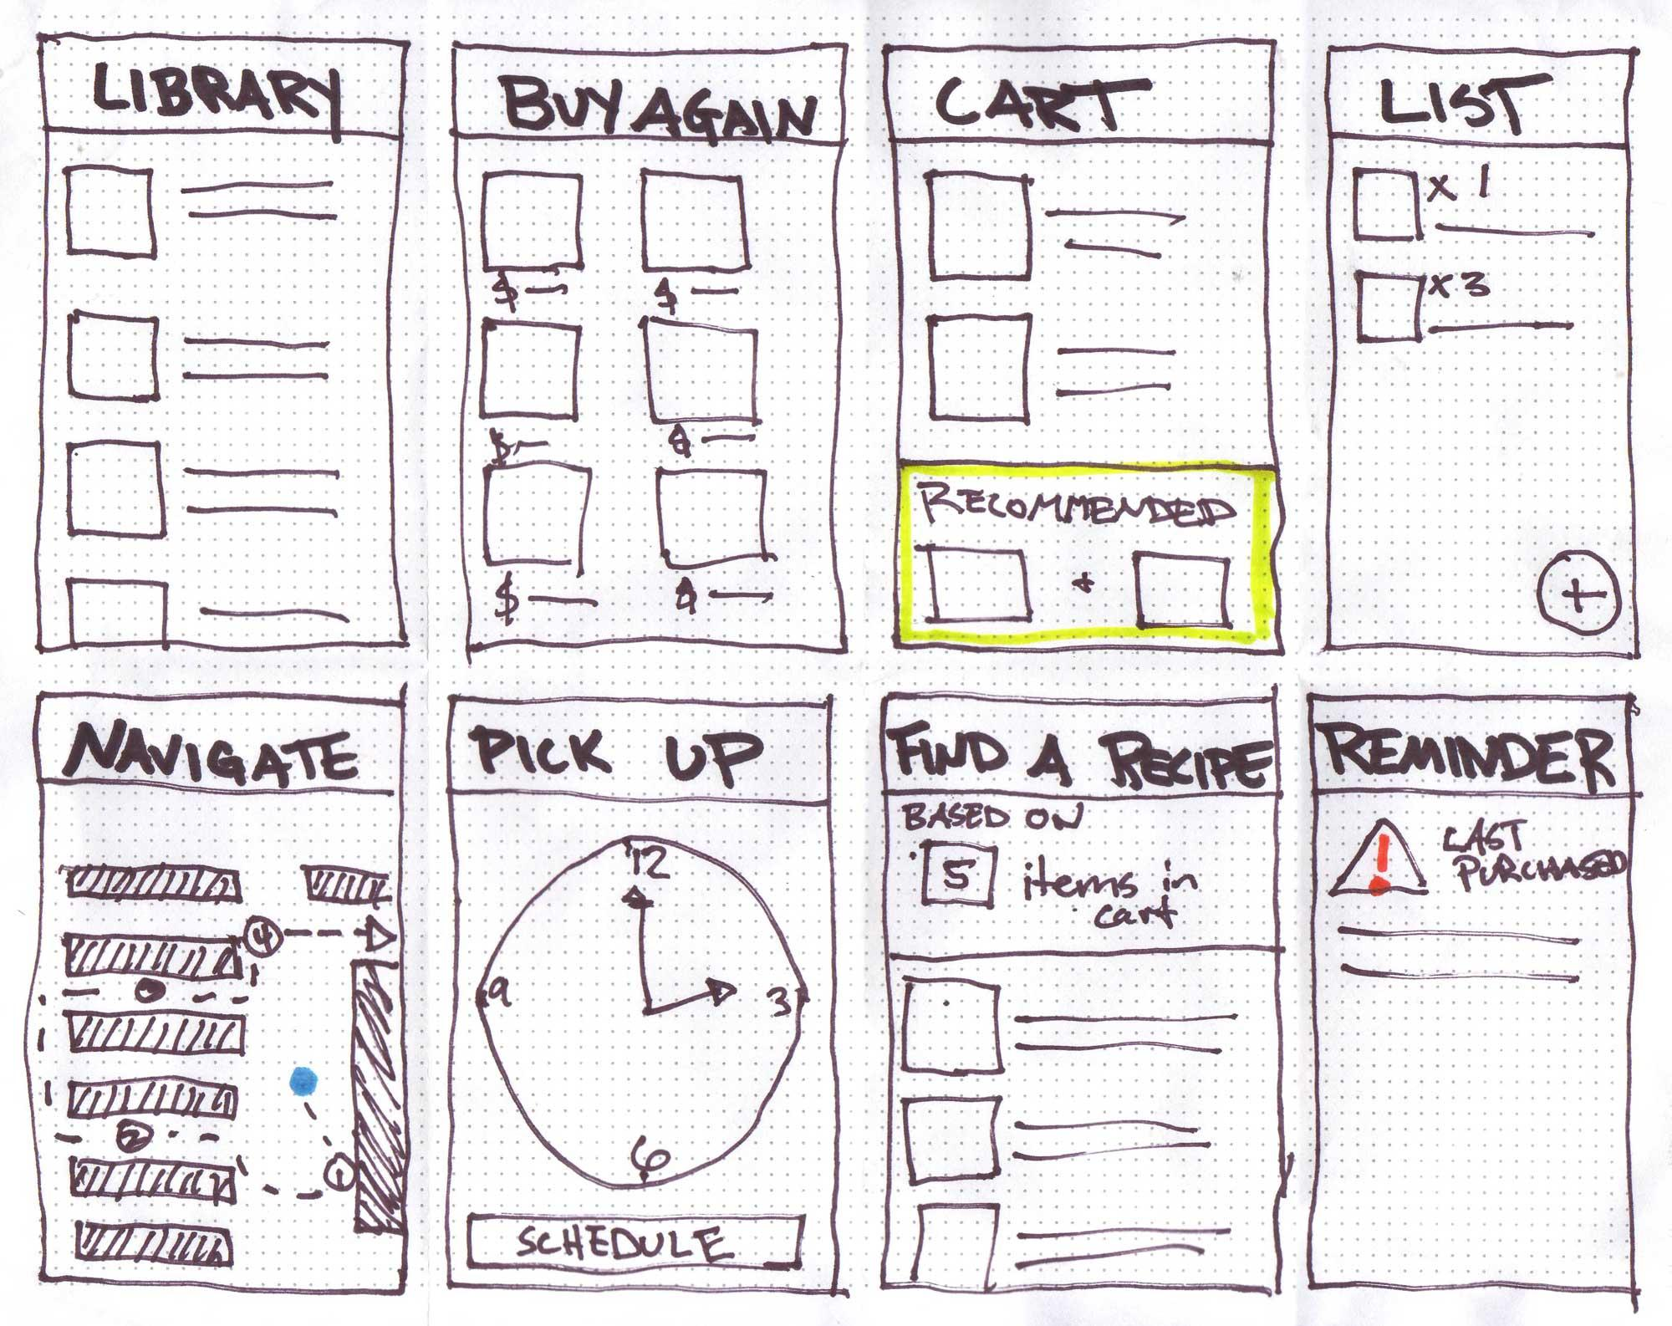
8 Sketches
Photo of your 8 sketches here

Slide 12
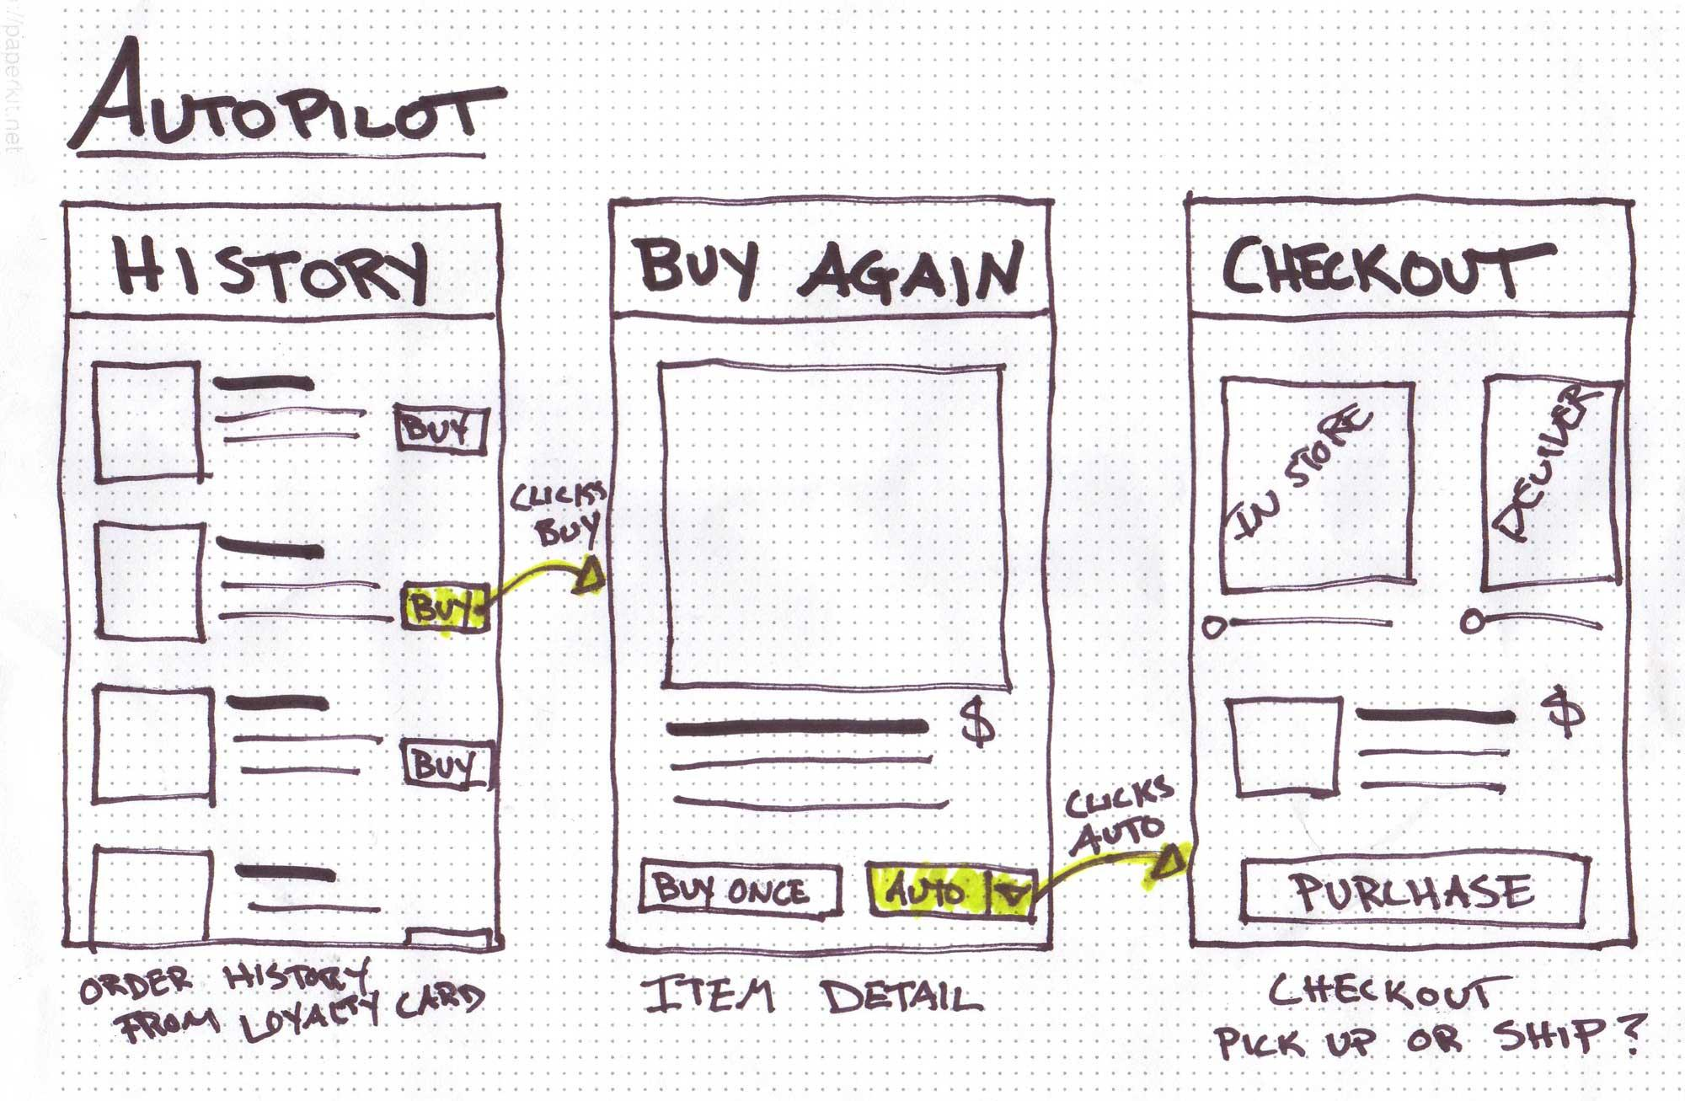
Solution Sketch 1
Upload a photo of your sketch on this slide

Slide 13
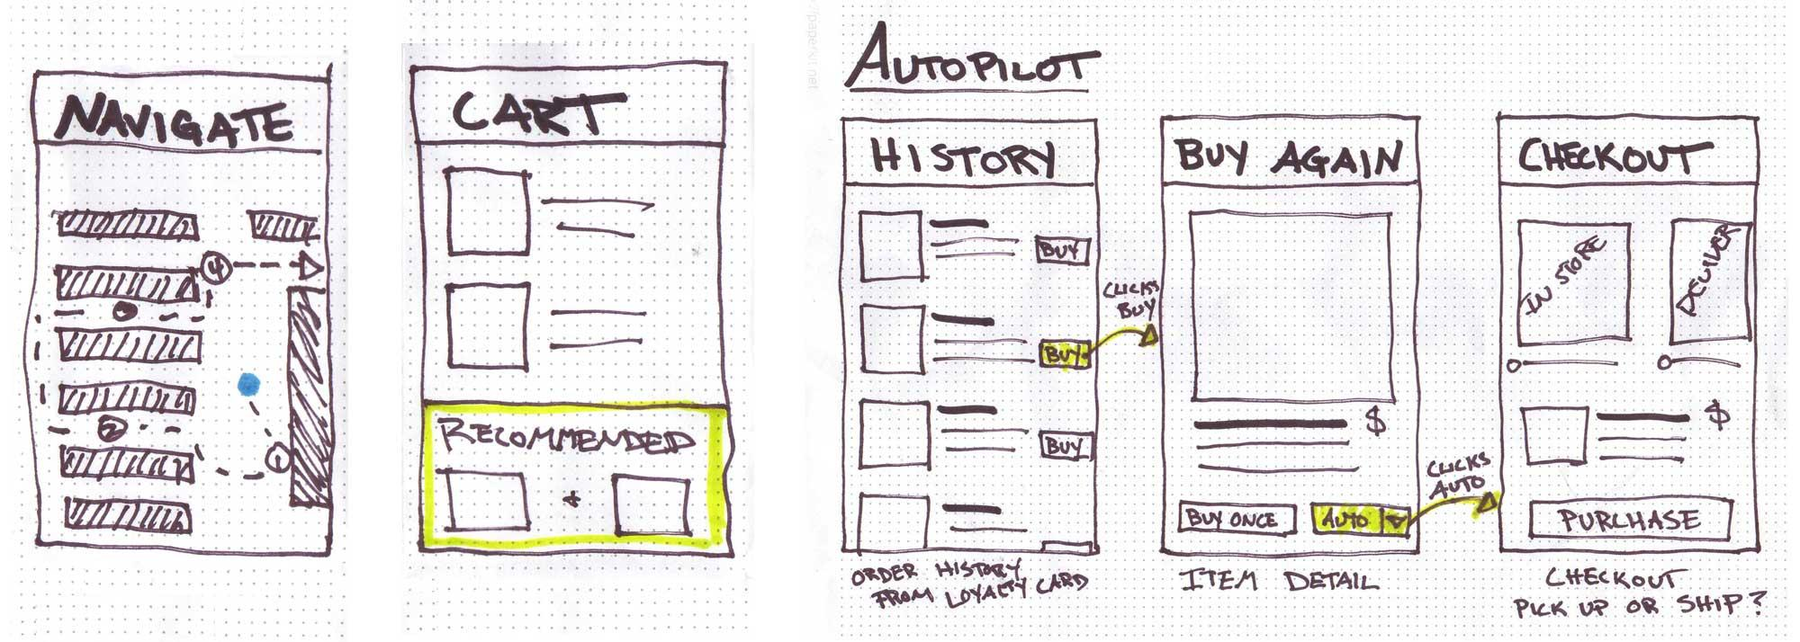
Solution Sketch 2

Slide 14
Decide
Pick the final concept that you develop into a prototype
© 2019 Udacity. All rights reserved.
Notes:
[ALL PARTICIPATION]

Slide 15
Decision
Decision | Using our matrix decision we decide to create the reccomandations because has the High value and High effort please see image decision matrix solutions
Rationale | The customer value here is very high because we will recomends based on their past purchase the items that they order plus in case the items is not available a similar items.

Slide 16
Prototype
Turn your concept into a realistic, interactive prototype that you will use to validate your assumptions and ideas
© 2019 Udacity. All rights reserved.
Notes:
[ALL PARTICIPATION]

Slide 17

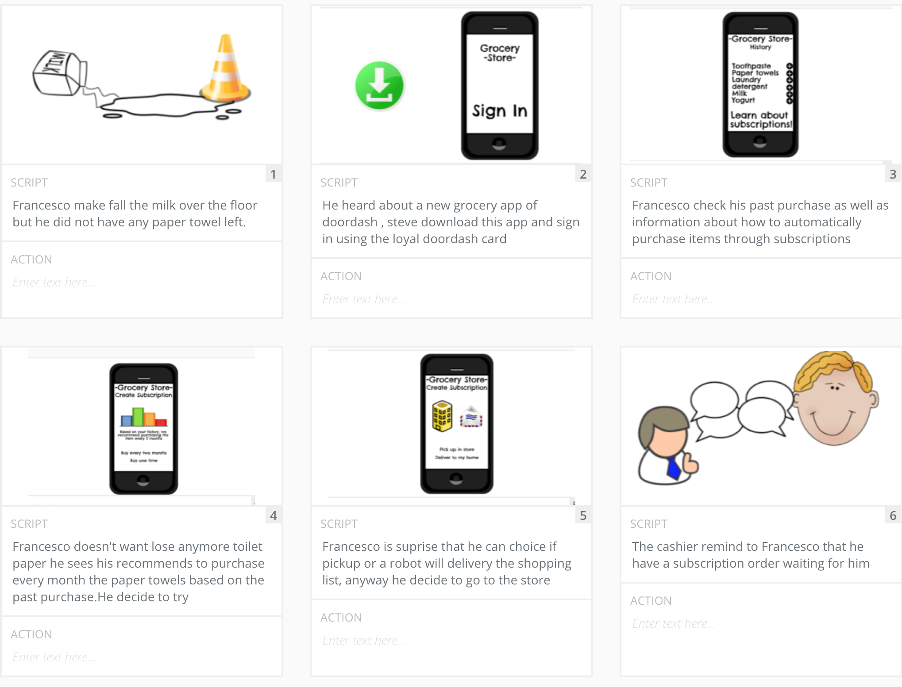
Storyboard
Link your plot
Upload your storyboard on this slide
Notes:
https://app.theplot.io/projects/c35bf152-4f5a-4f23-99f9-64a75f54d55b

Slide 18
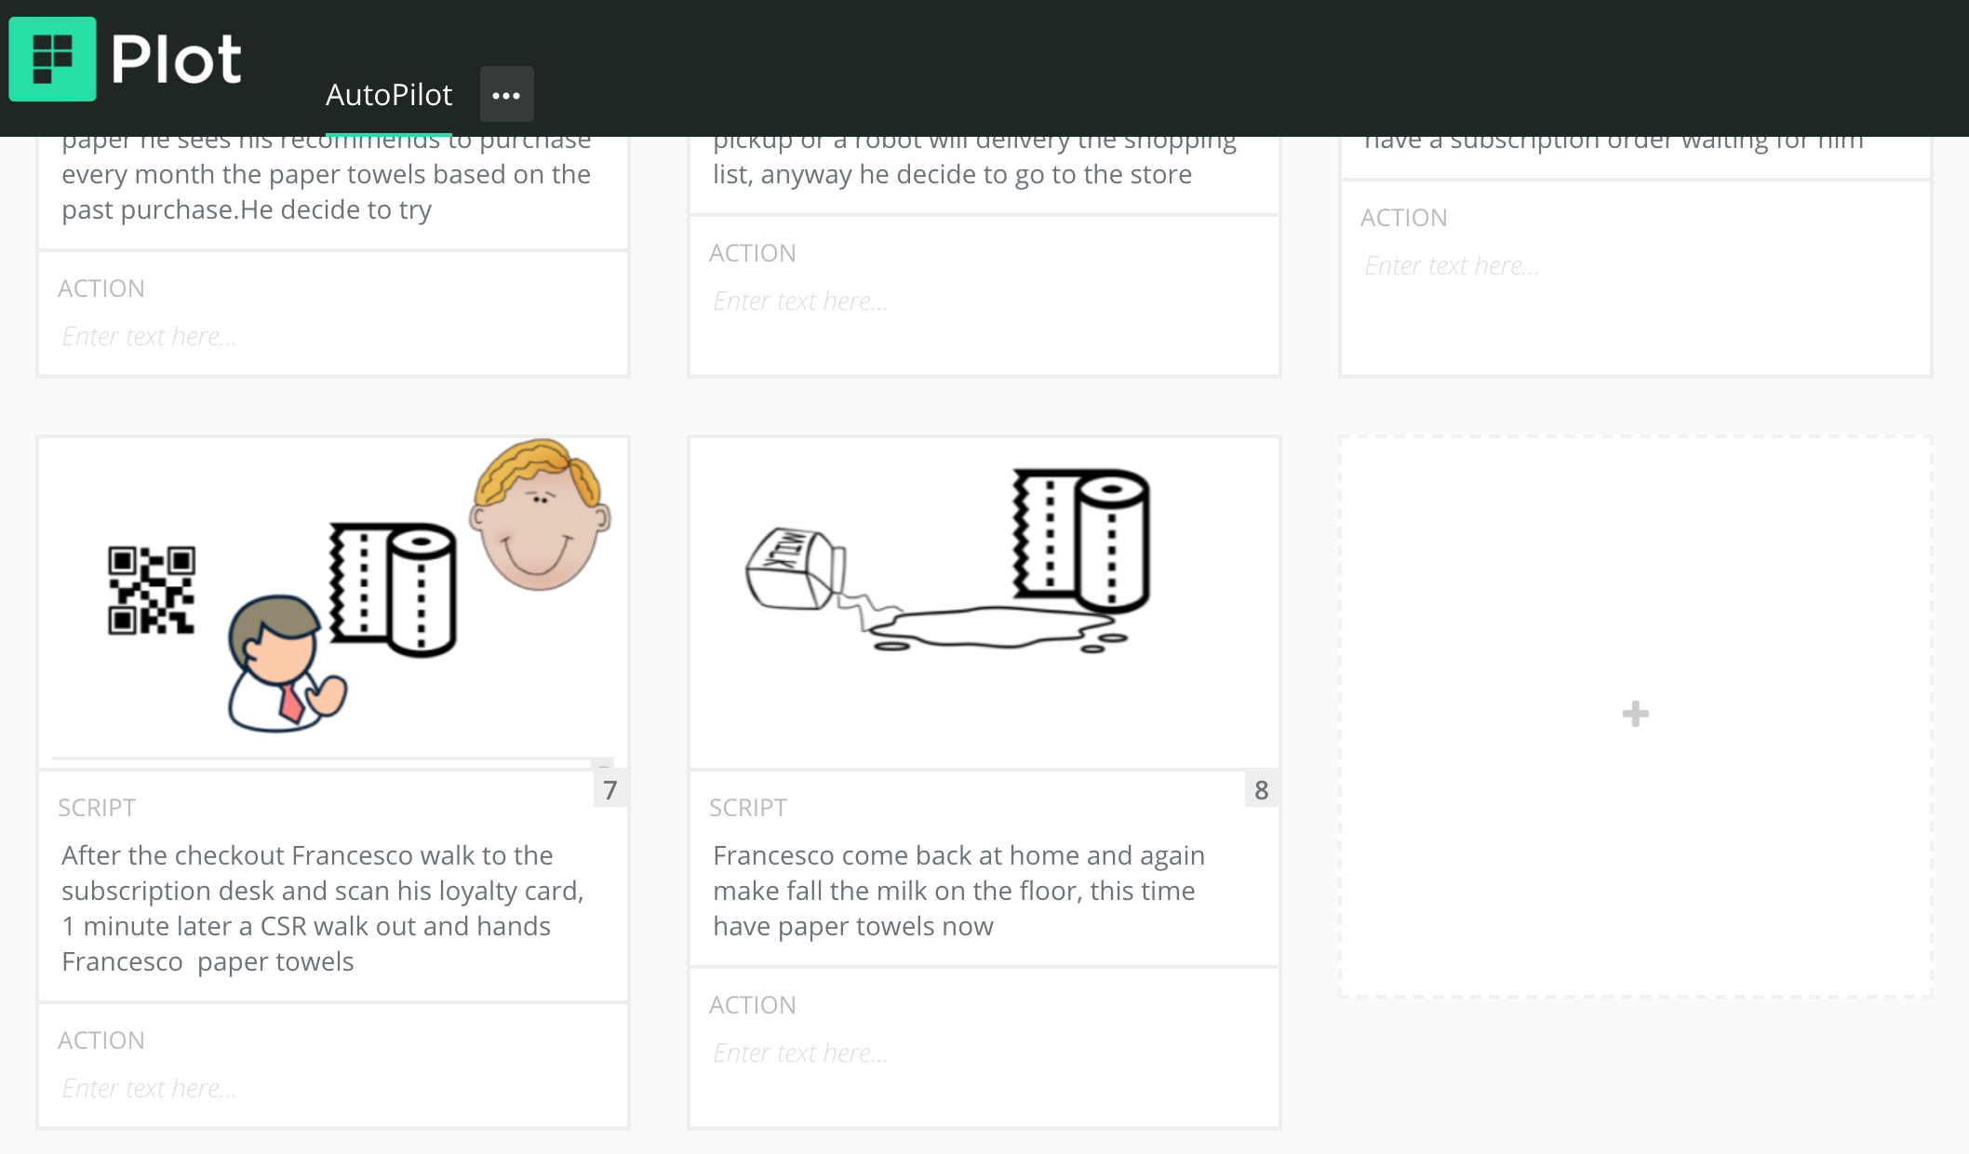
Storyboard
Link your plot
Upload your storyboard on this slide
Notes:
https://app.theplot.io/projects/c35bf152-4f5a-4f23-99f9-64a75f54d55b

Slide 19

Prototype
Description High level overview of the prototype What does it do? | Its does the sign in select my postcode check the store next to me and buy the papel towel and select if pickup or deliveyy
Assumptions Any assumptions within the prototype | List all assumptions you have made about the prototype He is an customer He needs to buy something He is interest to buy with the reccomend system
Tasks What are the tasks that a user can complete in the prototype? | Receive an SMS with a code for Sign Im Receive the auto reccomend items Buy the items that I need with reccomendation Checkout
Link your prototype
https://www.figma.com/proto/XFMj1w9n82gWBZQRpZTnYm/Untitled?node-id=1%3A370&scaling=min-zoom
Notes:
https://www.figma.com/file/GTdTcoXmFcaoICp5tI51pm/Doordash-Autopilot?node-id=0%3A1

Slide 20
Validate
Users will go through your prototype and provide feedback on your concept. This is also an opportunity to have an engineering feasibility discussion
© 2019 Udacity. All rights reserved.
Notes:
[ALL PARTICIPATION]

Slide 21
Plan and recruit for research
Link your research plan

Slide 22

User Testing
Check my
notes
Check Marco Zip file
Key Findings from Participant 1
What worked well | Marco downloaded correctly without any problem the app
Where participants got stuck | Marco had a problem with the ZipCode that was not recognize.
Other observations | Marco had a problem with the zipcode however after using a zip code that was working he used the app without problem Check the notes about the general feedback about the new features

Slide 23
User Testing
Check my notes.doc
Check my tom rar
Key Findings from Participant 2
What worked well | Tom managed to download the app and use it correctly
Where participants got stuck | Tom has any problem with the zip code, Tom received the sms quickly , Tom as well manage to create a recursive order using our new feature
Other observations | Tom suggest a better layout and lory may use more our app in future. Check my personal notes.

Slide 24
Improvements
Improvement #1 | Improvement the Zip Code
Rationale | We need to check all the Zip code availability in the city that we provide the services We may use an auto complete for the Zip Code
Improvement #2 | Better layout and autocomplete
Rationale | We can use def a better layout for the final App I would use the Autocomplete as well for the search product.

Slide 25
Handoff
© 2019 Udacity. All rights reserved.
Notes:
[ALL PARTICIPATION]

Slide 26
Updated PRD
Link your PRD

